Slide 1
Module 2: Basic Machine Learning

Slide 2
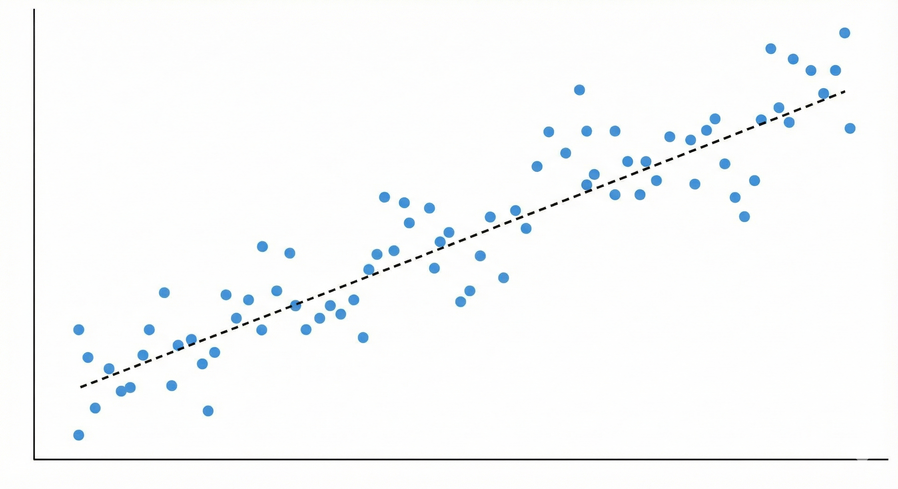
Machine learning doesn’t have to be complicated.
Made with Nano Banana
Find y = mx + b so that the sum of the squared distances of all data points (x) from the line (y) are minimized. Thus, minimize L2 loss, i.e., mean squared error (MSE). In other words, find a line that fits the data.
You probably did this in middle school or high school on a TI-89.

Slide 3
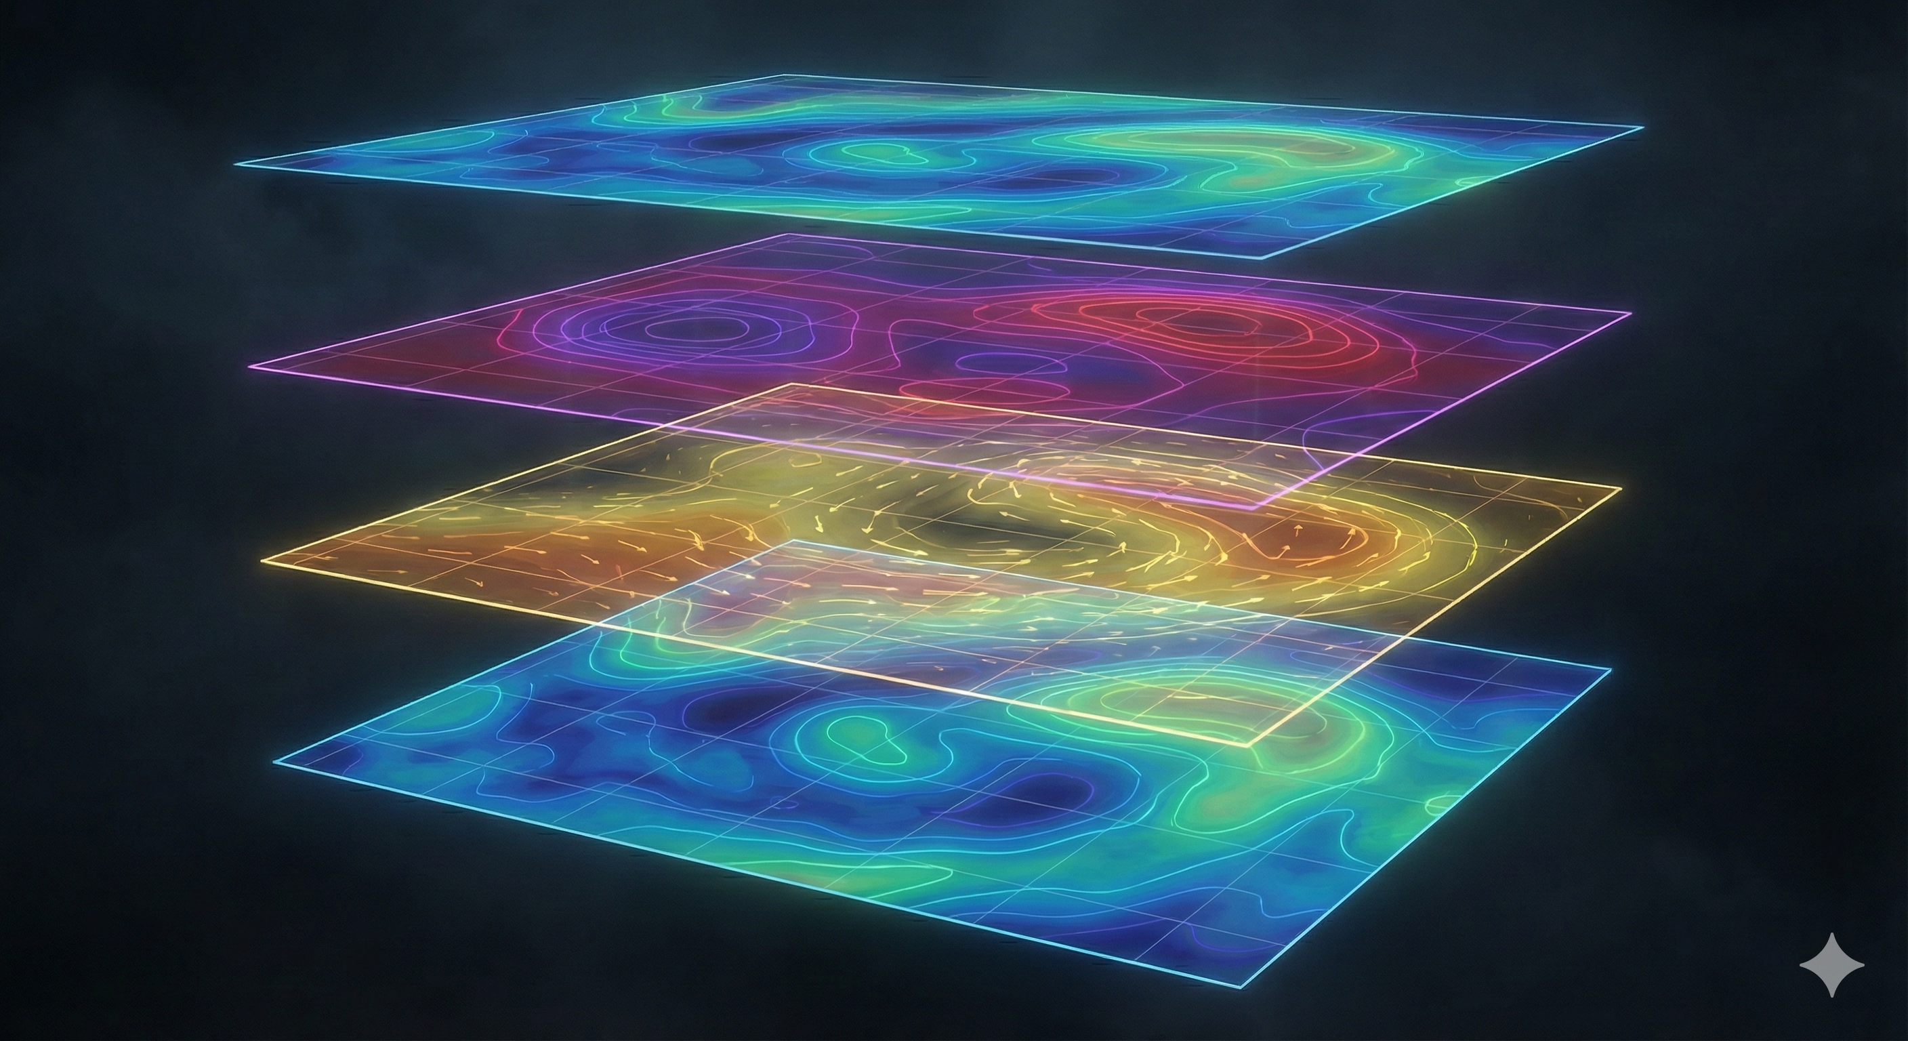
But it can be
Made with Nano Banana
Find the hyperparameter set that optimizes a generalized fit to multi-dimensional data that also varies through time.
You probably have never done this.

Slide 4
ML has been used in weather prediction for decades…
Model Output Statistics (MOS)
Predictors:
NWP Model Forecasts
Prior Observations
Geoclimatic Data
KMRY GFS MOS GUIDANCE 12/09/2025 0000 UTC
DT /DEC 9 /DEC 10 /DEC 11 /
HR 06 09 12 15 18 21 00 03 06 09 12 15 18 21 00 03 06 09 12 18 00
X/N 69 45 73 46 73
TMP 47 45 44 43 60 64 62 54 50 49 48 48 64 68 65 56 52 50 49 64 65
DPT 41 40 39 37 43 45 48 46 42 41 40 37 43 45 49 48 44 43 41 43 50
CLD CL FW CL CL CL CL CL CL CL CL CL CL CL CL CL CL CL CL CL CL CL
WDR 11 10 11 11 35 36 35 10 10 11 11 11 02 36 36 10 11 12 11 35 36
WSP 03 02 02 03 02 04 02 03 02 02 02 03 02 05 02 03 03 03 02 02 02
P06 0 0 0 0 0 0 0 0 0 1 0
P12 1 0 1 1 1
Q06 0 0 0 0 0 0 0 0 0 0 0
Q12 0 0 0 0 0
T06 0/ 2 0/ 1 0/ 0 0/ 0 0/ 4 0/ 0 0/ 0 0/ 2 0/ 0 0/ 0
T12 0/ 4 0/ 3 0/ 4 0/ 2 0/ 0
POZ 0 1 1 0 0 0 0 0 1 1 0 0 0 0 0 0 1 1 1 0 0
POS 0 0 0 0 0 0 0 0 0 0 0 0 0 0 0 0 0 0 0 0 0
TYP R R R R R R R R R R R R R R R R R R R R R
CIG 8 8 8 8 8 8 8 8 8 8 8 8 8 8 8 8 8 8 8 8 8
VIS 7 7 7 5 7 7 7 5 7 7 7 5 7 7 7 5 7 3 2 7 7
OBV N N N BR N N N HZ N N N BR N N N BR N BR FG N HZ
Historically, a multi-linear regression

Slide 5
What makes a good problem for machine learning?
Data rich
What do we have in atmospheric science:
Surface stations (decades; global but biased toward populated, wealthy regions)
Weather balloons (decades; global but biased toward populated, wealthy regions)
Satellite data (years of high-resolution multispectral data)
Can be used to remotely derive multiple quantities in true global manner
Buoy data (locally concentrated in areas of interest like equatorial Pacific and near shore)
Ship data (locally concentrated on ship paths)
Aircraft data (locally concentrated on ship paths)
This data is ingested (assimilated) into an atmospheric model of past weather and climate, known as reanalysis.

Slide 6
What data do we use? Usually reanalysis, although newer models experimenting with ML DA.
REMEMBER: Reanalysis is a model output that ingests any available observations.
Reanalysis has parameterizations:
Microphysics
Cumulus
Surface
Radiation
Turbulence/boundary layer
But is repeatedly nudged toward observations so it doesn’t stray too far from the truth.
Large-scale dynamic fields like wind are often good.
Local fields like precipitation depend on parameterization and often have large errors and biases. This can indirectly impact other variables like relative humidity.
Other important variables like temperature depend on height. Upper-level usually well constrained, but near-surface values can suffer biases.
Many of today’s ML weather models use reanalysis as the truth, but the truth still contains errors!

Slide 7
A
Artificial Intelligence (AI)
Machine Learning (ML)
Deep Learning incl. neural networks (NN)
Natural language processing (NLP)
Numerous other models
Lots of other ellipses could fit in here.

Slide 8
How does a neural network function?
A neural network is essentially a mathematical framework for transforming input into output—except instead of using derived equations, the transformations are learned using data.
Input layer
Output layer
Hidden layers

Slide 9













How does a neural network function?
$$W_{1,1}^{1}, b1$$
$$h_{1}^{1}$$
$$h_{1}^{2}$$
x₁
y₁
$$h_{2}^{1}$$
$$h_{2}^{2}$$
x₂
y₂
$$h_{3}^{1}$$
$$h_{3}^{2}$$
x₃
y₃
$$W_{4,3}^{1}, b4$$
$$h_{4}^{1}$$
$$h_{4}^{2}$$
$$h_{j}^{1}=σ\left(\sum_{i=1}^{n}{W_{j,i}^{1}}x_{i}+b_{j}^{1}\right)$$
$$h_{j}^{2}=σ\left(\sum_{i=1}^{n}{W_{j,i}^{2}h_{j}^{1}}+b_{j}^{2}\right)$$
$$y_{j}=σ\left(\sum_{i=1}^{n}{W_{j,i}^{3}h_{j}^{2}}+b_{j}^{3}\right)$$

Slide 10






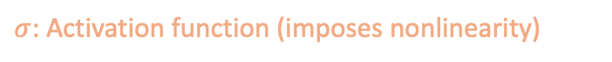








How does a neural network function?
$$h=σ\left(Wx+b\right)$$
$$W_{1,1}^{1}, b1$$
$$h_{1}^{1}$$
$$h_{1}^{2}$$
x₁
y₁
$$h_{2}^{1}$$
$$h_{2}^{2}$$
x₂
y₂
$$h_{3}^{1}$$
$$h_{3}^{2}$$
x₃
y₃
$$W_{4,3}^{1}, b4$$
$$h_{4}^{1}$$
$$h_{4}^{2}$$
$$h_{j}^{1}=σ\left(\sum_{i=1}^{n}{W_{j,i}^{1}}x_{i}+b_{j}^{1}\right)$$
$$h_{j}^{2}=σ\left(\sum_{i=1}^{n}{W_{j,i}^{2}h_{j}^{1}}+b_{j}^{2}\right)$$
$$y_{j}=σ\left(\sum_{i=1}^{n}{W_{j,i}^{3}h_{j}^{2}}+b_{j}^{3}\right)$$
h: hidden layers (new representation of data)
x: input layers (normalized data)
W: weights per neuron (learned)
$σ$: Activation function (imposes nonlinearity)
b: biases (learned per neuron)

Slide 11
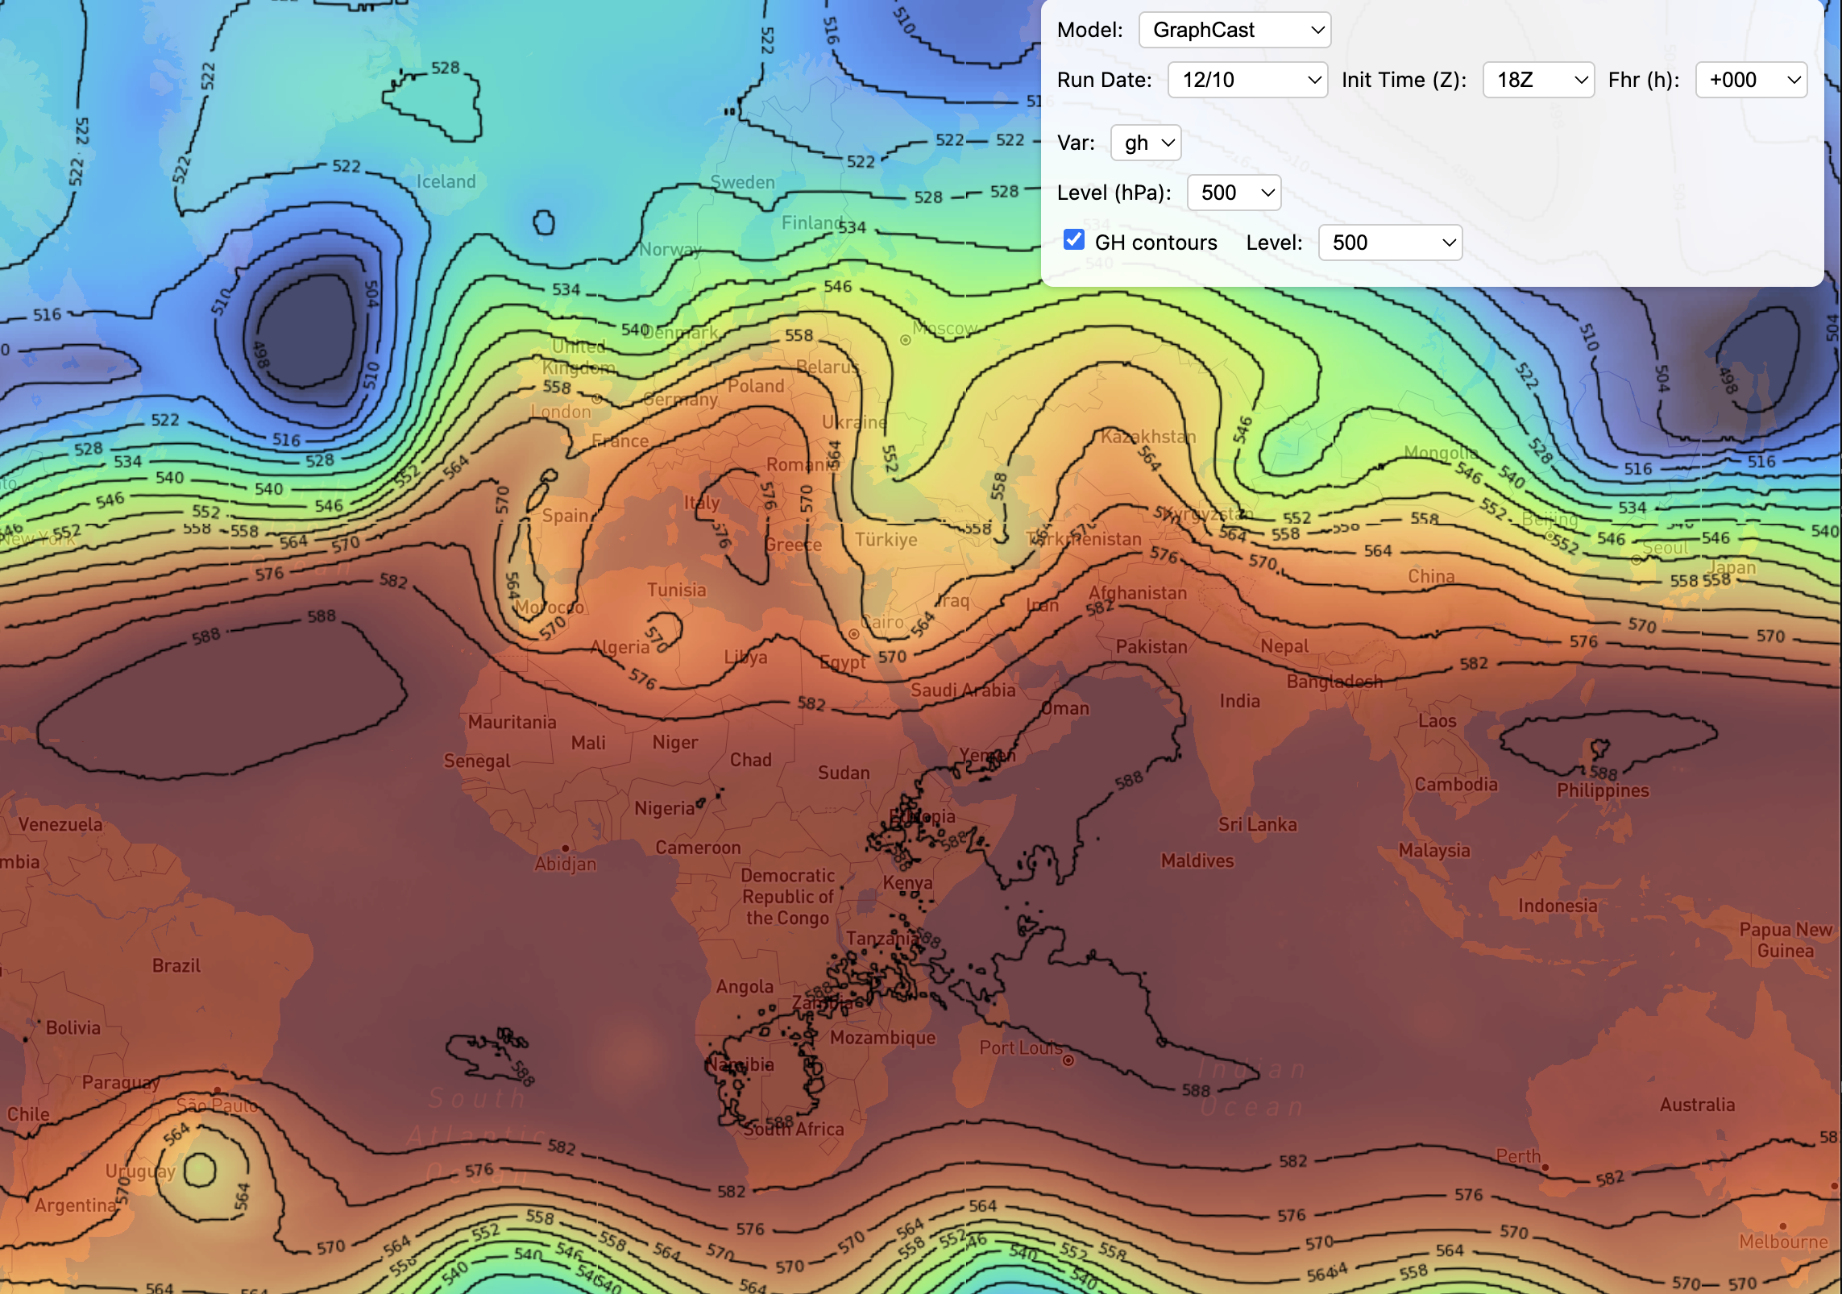
But…
This is a fully connected neural network (FCNN). That means every neuron in any layer talks to every neuron in each layer before and after it.
How does a neural network function?
$$h=σ\left(Wx+b\right)$$
$$W_{1,1}^{1}, b1$$
$$h_{1}^{1}$$
$$h_{1}^{2}$$
x₁
y₁
$$h_{2}^{1}$$
$$h_{2}^{2}$$
x₂
y₂
$$h_{3}^{1}$$
$$h_{3}^{2}$$
x₃
y₃
Do dynamics here…
$$W_{4,3}^{1}, b4$$
$$h_{4}^{1}$$
$$h_{4}^{2}$$
…impact the forecast here 6 hours later?
$$h_{j}^{1}=σ\left(\sum_{i=1}^{n}{W_{j,i}^{1}}x_{i}+b_{j}^{1}\right)$$
$$h_{j}^{2}=σ\left(\sum_{i=1}^{n}{W_{j,i}^{2}h_{j}^{1}}+b_{j}^{2}\right)$$
$$y_{j}=σ\left(\sum_{i=1}^{n}{W_{j,i}^{3}h_{j}^{2}}+b_{j}^{3}\right)$$
h: hidden layers (new representation of data)
x: input layers (normalized data)
W: weights per neuron (learned)
Imagine every variable at every grid point in a discretized model is a neuron. Using a FCNN would be nonsensical.
$σ$: Activation function (imposes nonlinearity)
b: biases (learned per neuron)

Slide 12
Convolutional neural networks (CNNs) take advantage of spatial information.
Interactive CNN Visualization: https://poloclub.github.io/cnn-explainer/
Z₅₀₀
Convert 2D inputs into 2D outputs
Z₂₀₀
Z₈₅₀
Z₅₀₀
P_{sfc}
P_{sfc}
T_{2m}
T_{2m}
q_{2m}
Precip
Inputs (examples shown)
Outputs (could be same as or different than inputs)

Slide 13
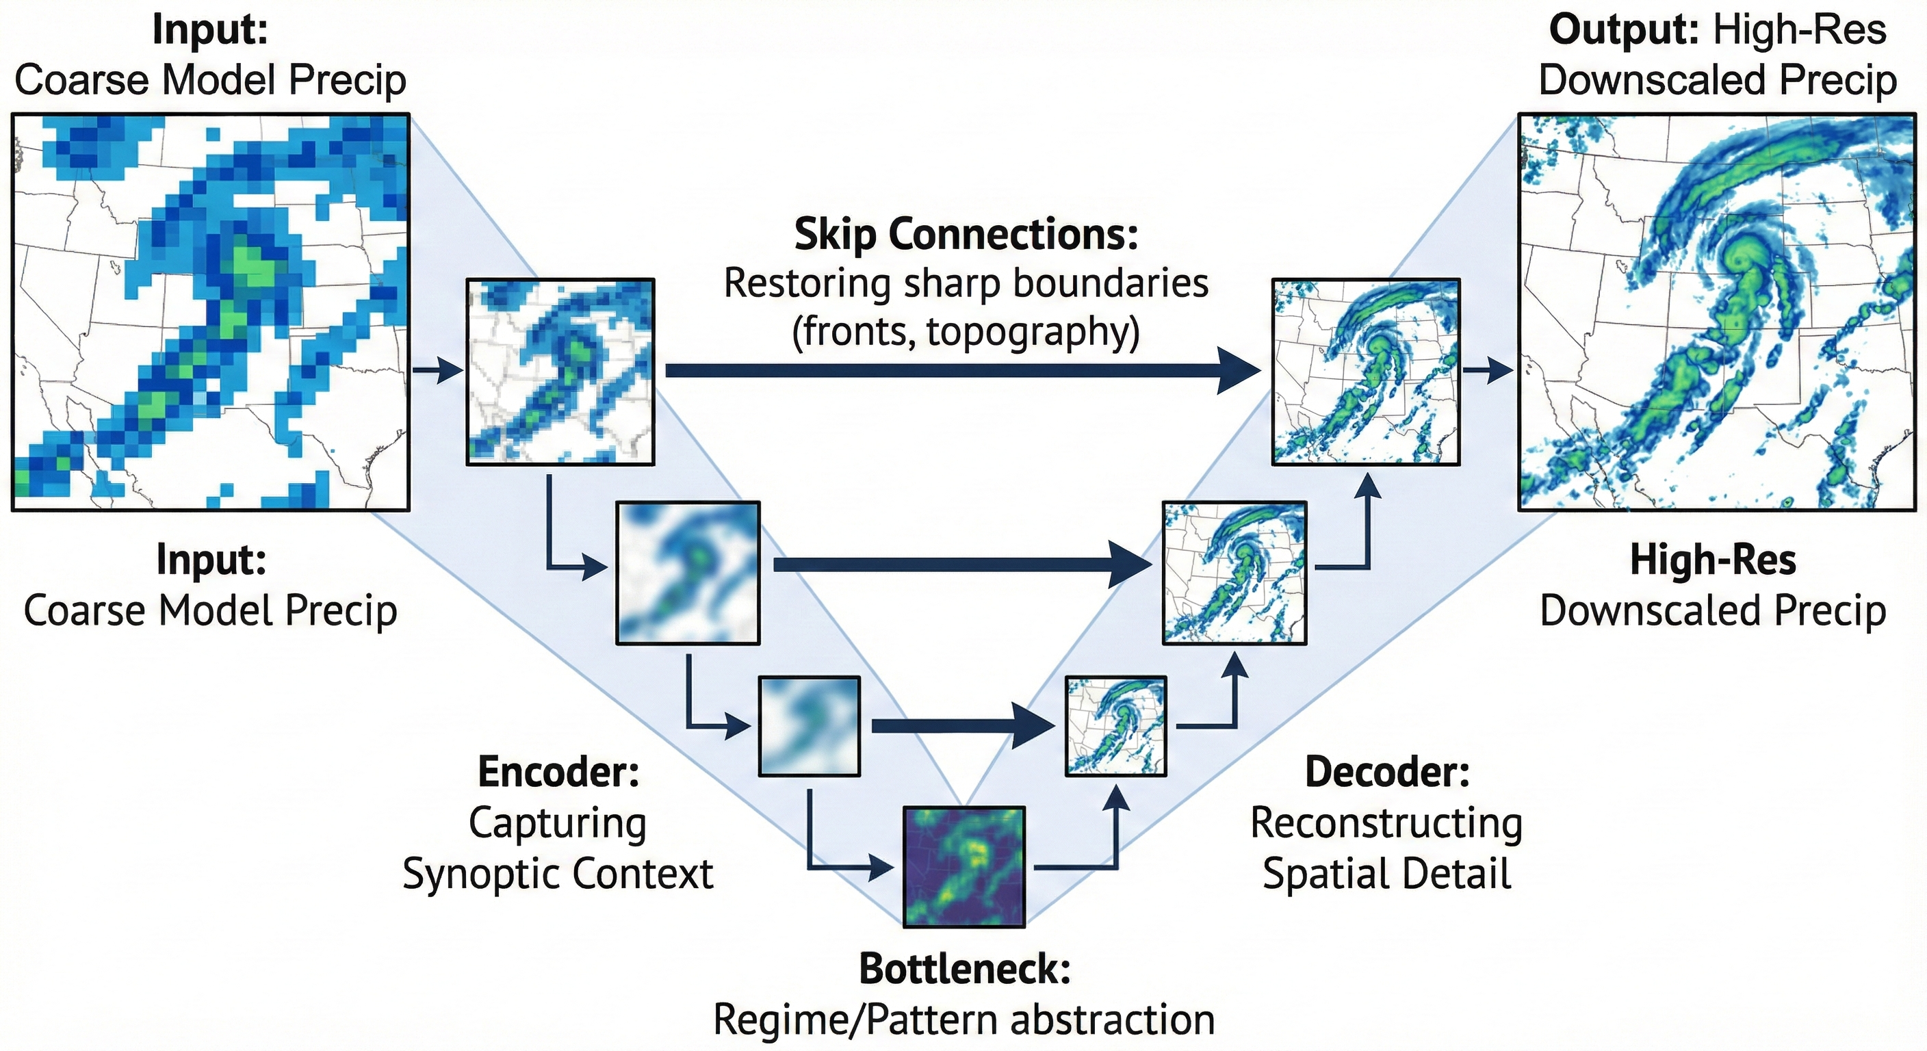
CNNs can have various different types of architecture.
Below is a common type of CNN: A U-Net architecture. This is example of image sharpening.
Downsampling
Upsampling
Generated with Nano Banana

Slide 14
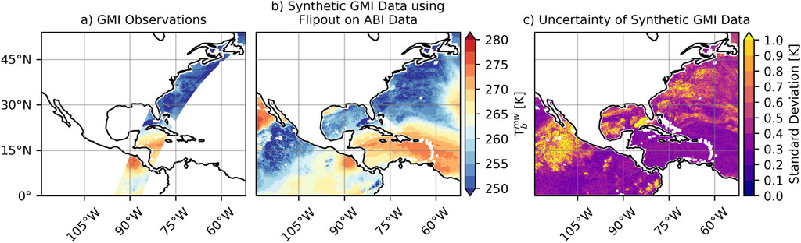
Bayesian ResNet architecture: Emulate microwave satellite data using geostationary IR data with uncertainties predicted
Below
Single observed MW
swath
Full scene of predicted MW data
Standard deviation of predictions
This is also a CNN.

Slide 15
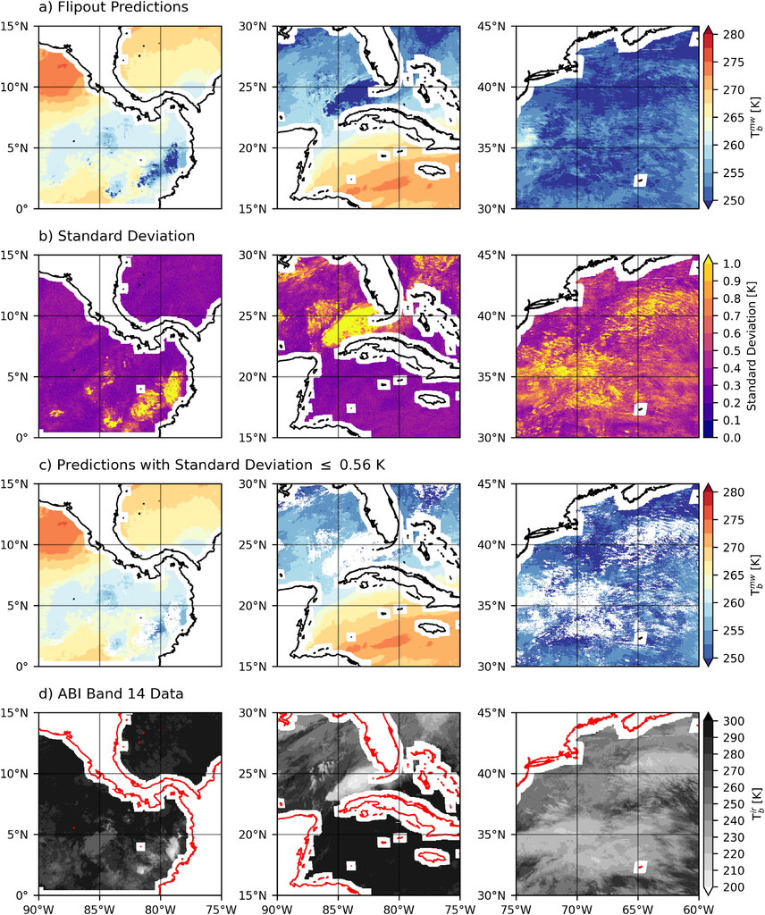
Predictions
Uncertainty metric
Mask out uncertain regions
Part of the input tensor

Slide 22
Overlapping patches (often overlap of 0.5).
Each patch leads to a prediction of a patch.
Patches are then pieced together to form a predicted image.
CNNs were state-of-the-art circa 2020. However, these are no longer used for weather prediction because they are local operators. Real atmospheric dynamics are not dependent on just local processes!

Slide 23

How do we use available data to train ML models of the atmosphere?
z-score normalization
$$z=(X−μ)/σ$$
Z₅₀₀
z_{Z500}
Z₂₀₀
z_{Z200}
Z₈₅₀
z_{Z850}
Input tensor to encoder
P_{sfc}
z_{Psfc}
T_{2m}
z_{T2m}
q_{2m}
z_{q2m}
Raw data fields
(These do not go into training!)
Normalized fields (mean = 0; stdev = 1)

Slide 24
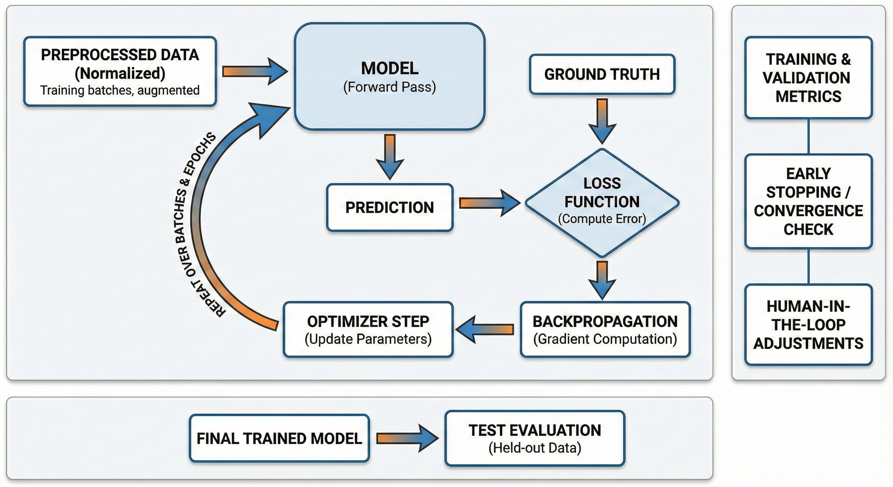
Is my model still learning?
Do I need to adjust my learning rate?
Generated using Nano Banana
(e.g., ERA5)
Validation
Batch: Subset of data
Epoch: One cycle through entire dataset
Training loop
Testing
This data MUST be left out of training! This is required to show the model performs well on unseen data.

Slide 25
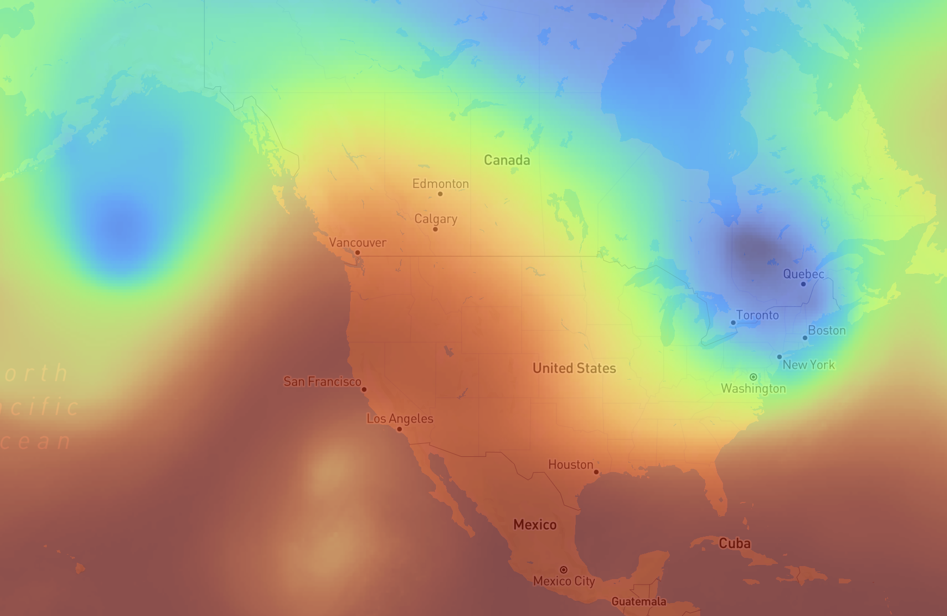
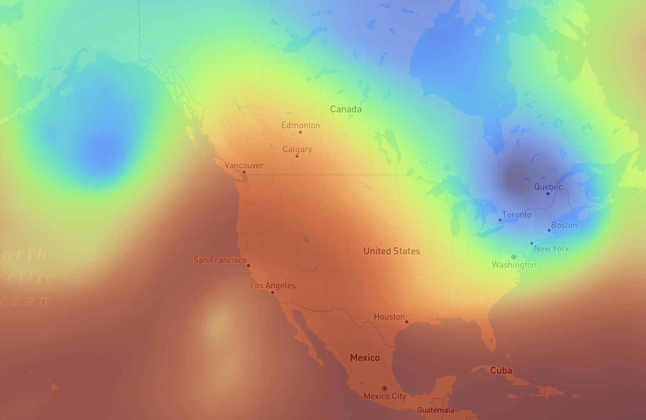
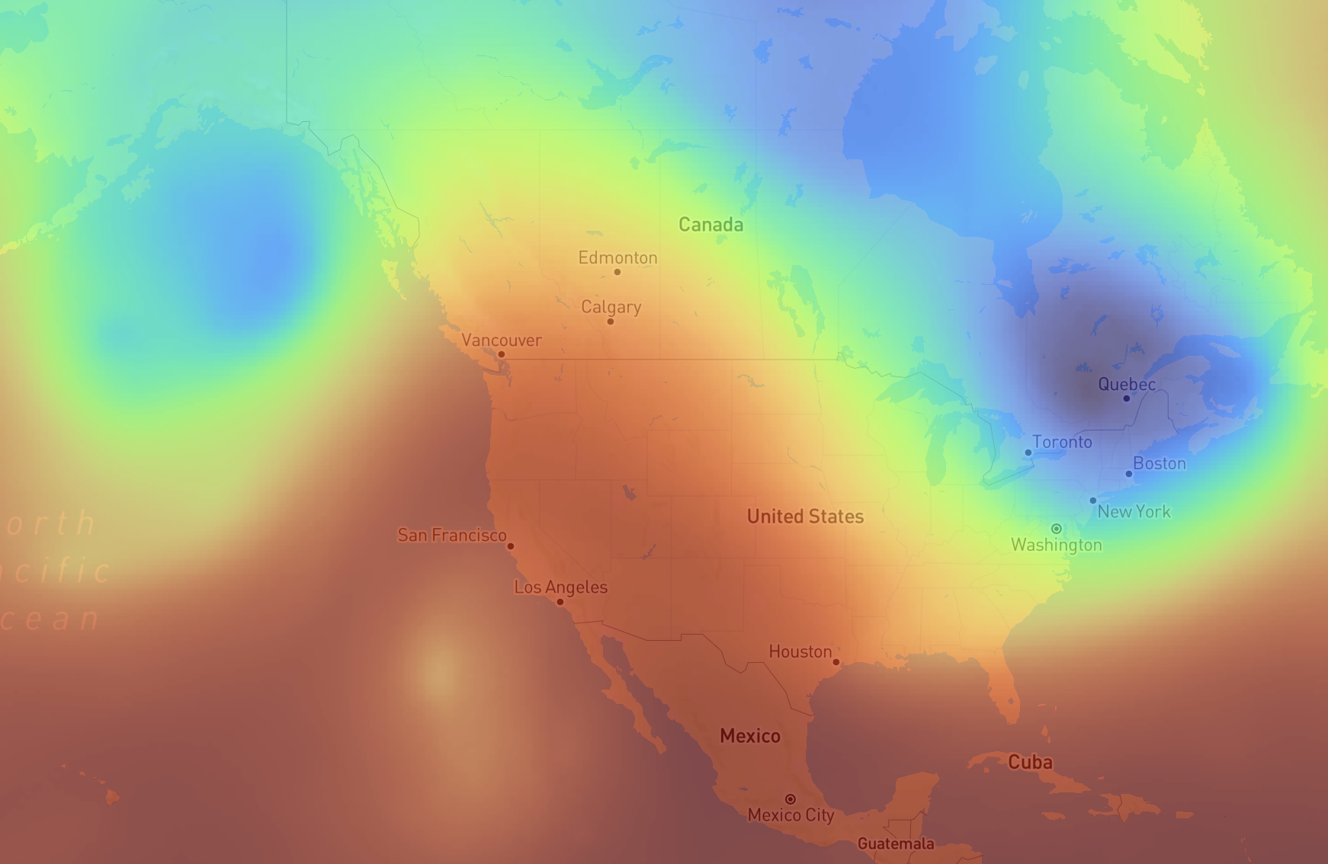
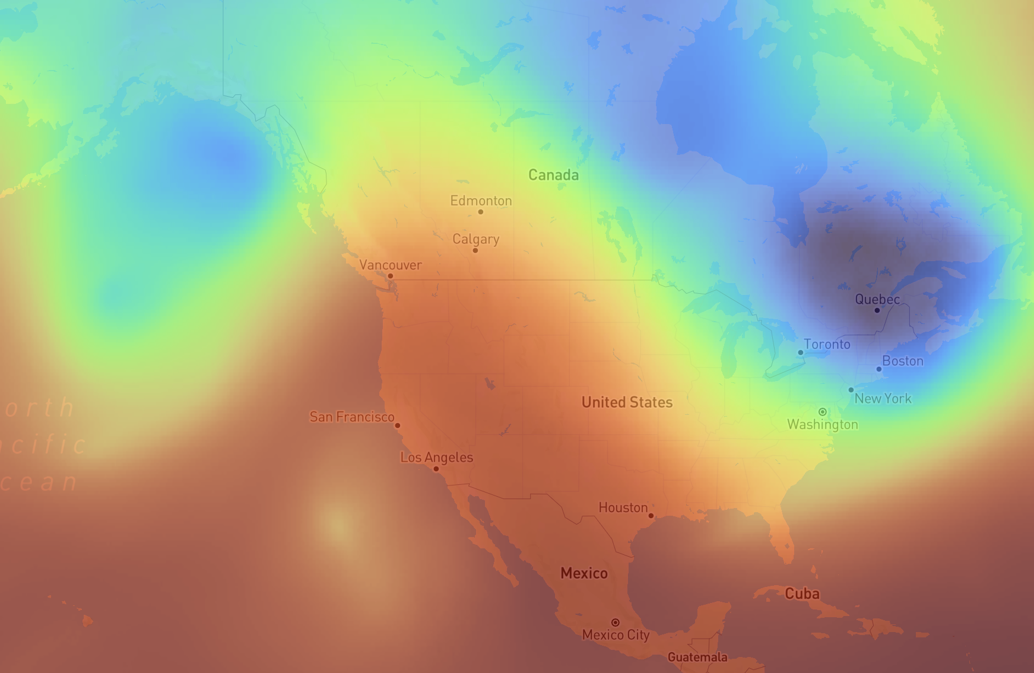
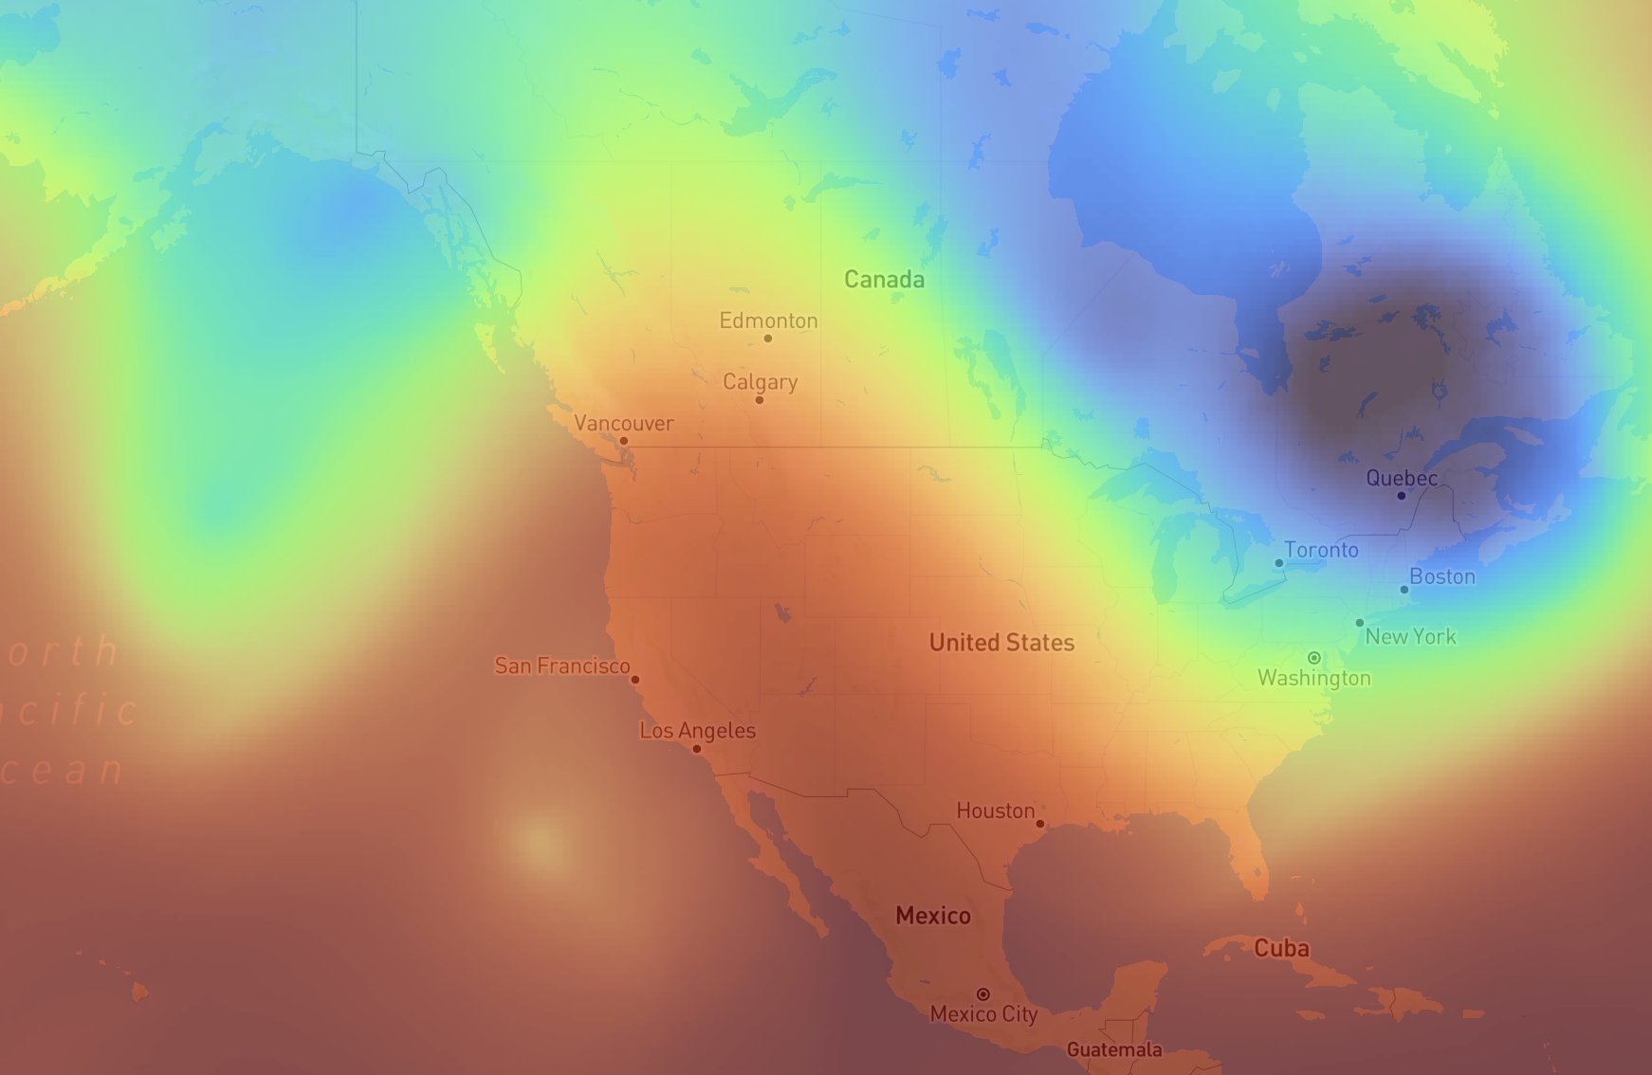
Error in ML Models
ML models don’t integrate equations forward in time. But they still have similar limits of predictability. What produces the error?
Not propagating errors mathematically.
But there is still information content error in autoregressive models.
06 hr is IC for 12 hr.
12 hr is IC for 18 hr…and so on…
So any error in the 12 hr prediction is an error in the input tensor for the 18 hr prediction. Eventually, prediction does not match the truth.
00 hr (”analysis”)
18 hr
06 hr
12 hr
24 hr

Slide 26
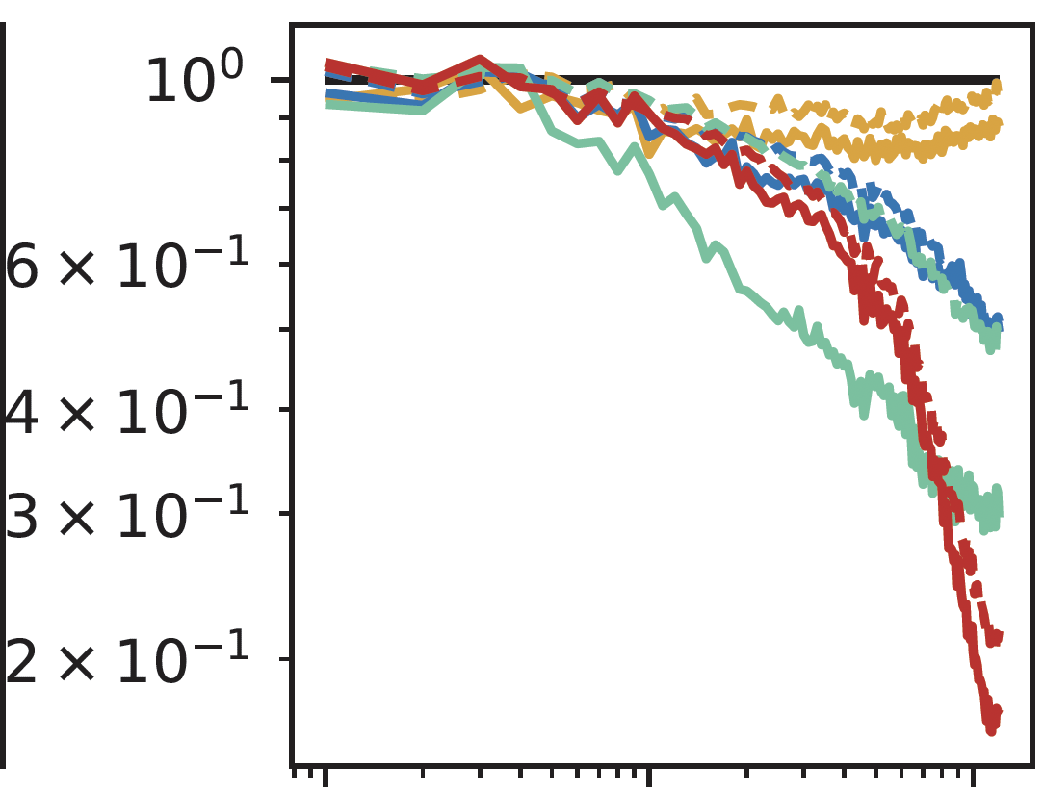
Error in ML Models
Normalized power spectra for wind speed in 15°S to 15°N
Smoothing
ML models universally underrepresent small scale weather.
Why? ML models aren’t trained to obey physics! They are trained to minimize a loss function.
Huge impacts for real day-to-day weather prediction (temperature, rainfall, wind, etc.).
Pangu
NeuralGCM
GraphCast
ECMWF HRES
ERA5
Dashed: 1-day forecast
Solid: 7-day forecast
Normalized spectral density
10⁰
10¹
10²
Zonal Wavenumber

Slide 27

Error in ML Models
Smoothing
Mean squared error (MSE) is often used as a loss function.
ML models universally underrepresent small scale weather.
Why? ML models aren’t trained to obey physics! They are trained to minimize a loss function.
Huge impacts for real day-to-day weather prediction (temperature, rainfall, wind, etc.).
Prediction
Truth
$$L=\frac{1}{N}\sum_{i=1}^{N}{{\left(x_{i}−{\hat{x}}_{i}\right)}^{2}}$$
Large errors are amplified!
Therefore, models learn to “play it safe” when trained. This causes them to lose vital information where a weather forecaster might care the most (where sharp gradients exist).

Slide 28
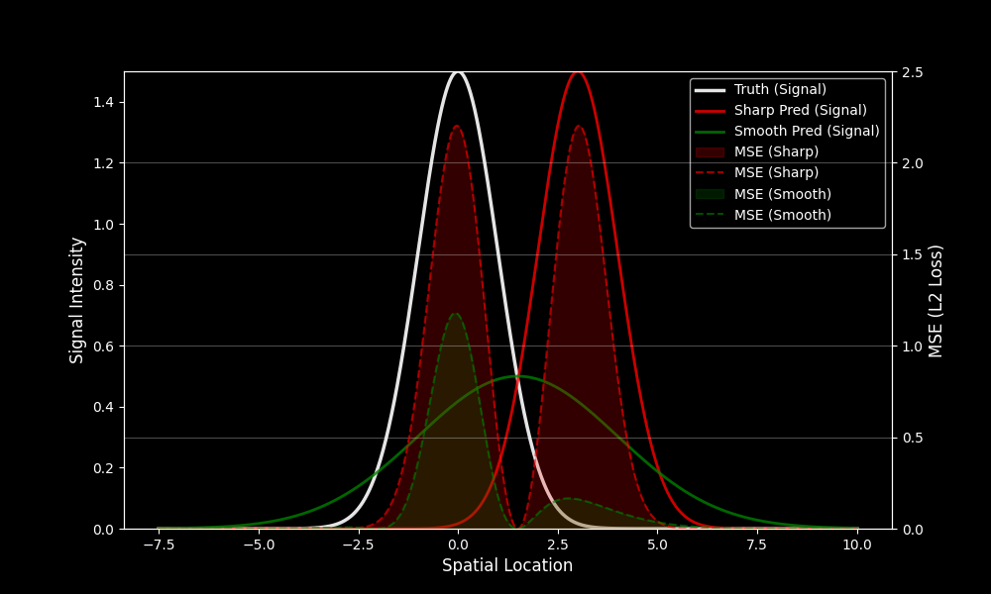
Mean L2 Loss (sharp): 0.41
Mean L2 loss (smooth): 0.12
Example of mean squared error (MSE)

Slide 29
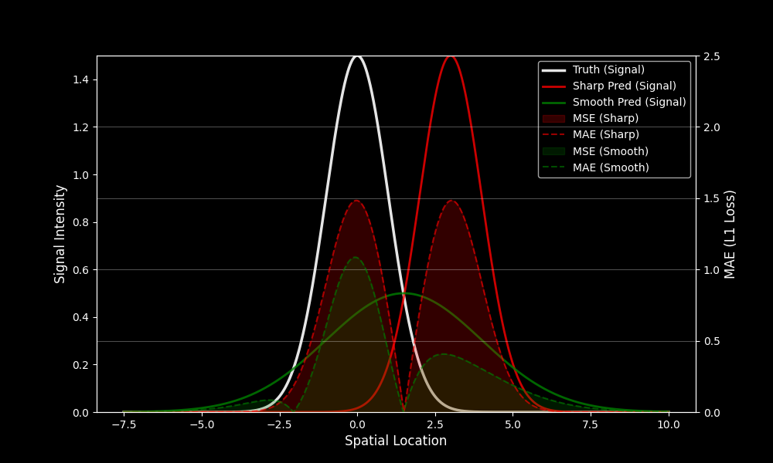
Mean L1 Loss (sharp): 0.37
Mean L1 loss (smooth): 0.21
Example of mean absolute error (MAE)
For high amplitude signals, L2 loss gets amplified much faster than L1 loss.
Spiky signals like heavy rain

Slide 30
Need a different way to characterize loss to have hope of predicting sharp, mesoscale features (e.g., fronts, tropical cyclones, precipitation).
Mean L1 Loss (sharp): 0.37
Mean L1 loss (smooth): 0.21
Example of mean absolute error (MAE)
For high amplitude signals, L2 loss gets amplified much faster than L1 loss.
Spiky signals like heavy rain

